Slide 1
Are Federal Contractors Less Innovative
Atlanta Conference on
Science and Innovation Policy
May 24, 2023
Brett Josephson, Anne Marie Knott and Yeon Lee

Slide 2
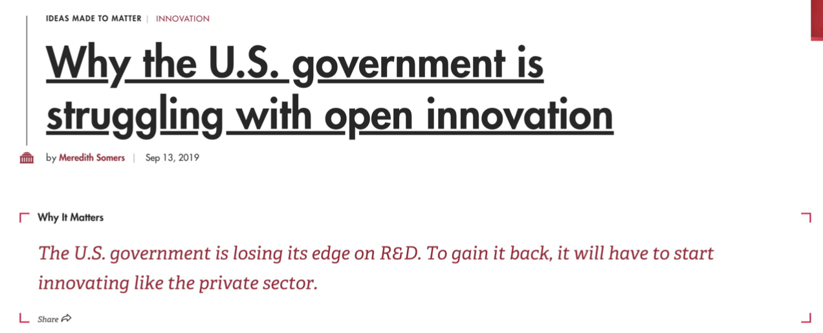



Lots of Claims that Federal Contractors Are Less Innovative

Slide 3
Innovation is the Primary Driver of Economic Growth
So we should be concerned that RQ has declined 65%

Slide 4
Decline in Federally-Funded R&D Almost Identical

Slide 5
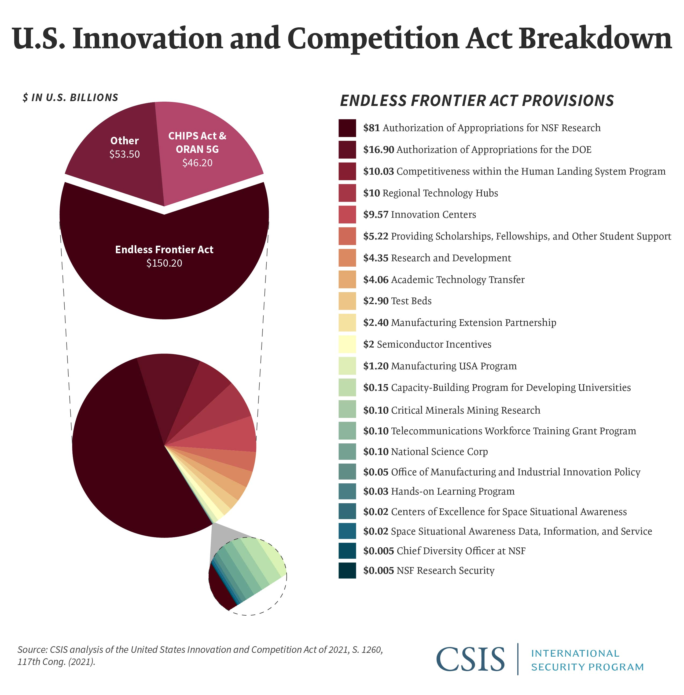

This Prompted Calls to Increase Funding for University Research

Slide 6
But the Decline was entirely Development Funding to Firms
RQ decline likely stems from decline in federal R&D to firms
The Puzzle: For that to be true:
Federal R&D contractors must have higher RQ

Slide 7
We Test Whether Federal R&D Contractors Have Higher RQ
Empirical Model:
RQ is the firm specific output elasticity of R&D
Data
WRDS RQ Database (derived from Compustat)
RQs for all publicly traded U.S. firms conducting R&D
USAspending.gov
Government R&D contract amounts
Drop firms with first contract before data window (2001)
RQ_{it} = β₁(post contract)_{it} + η_{i} + λ_{t} + ε_{it}

Slide 8
24% of U.S. R&D Firms Had >1 Federal R&D Contract (2001-2020)
Federal R&D contractors are:
50% larger
Almost 2x more R&D intensive (R&D/revenue)
Less likely to file patents
But their patents have greater impact 73% more cites

Slide 9
Main Result: Federal R&D Contractors Have Higher RQ

Slide 10
Is This Merely an Artifact?: Does the US fund R&D for Ultimate Procurements

Slide 11
Why Might Federal R&D Contracts Increase RQ?
It Takes Firms
in New Direction?
The R&D is More Impactful?

Slide 12
Summary
Federal R&D contractors appear to:
Be more innovative than ”commercial firms”
Become more innovative during the fed contract
Little of the effect is artifactual
Why federal R&D contracts might increase RQ
Mild evidence it takes firm in new directions
Patents more impactful, but also less likely
Implication: Decline in federal development likely contributed to the declines in RQ and GDP growth
Without federal D, most important technologies would never have been “on the shelf”
The reason government seems less innovative is that it hasn’t been developing new technologies!

